Slide 1

Text - Cleaning OCR Post-Processing Text Correction
Shripad Ambure
(942364)

Slide 2

Transformers
In 2017 Google researchers and developers released paper “Attention is all you need”, which highlighted the Rise of Transformers.
This architecture inspires from the mechanism used in encoder-decoder model in RNN to handle Seq2Seq Tasks. Meaning that unlike RNNs it doesn’t process data in sequence manner.
Transformers can parallelize sequential data and reduce the training time.
In transformers we pass all the words Simultaneously and determine word embeddings simultaneously.

Slide 3
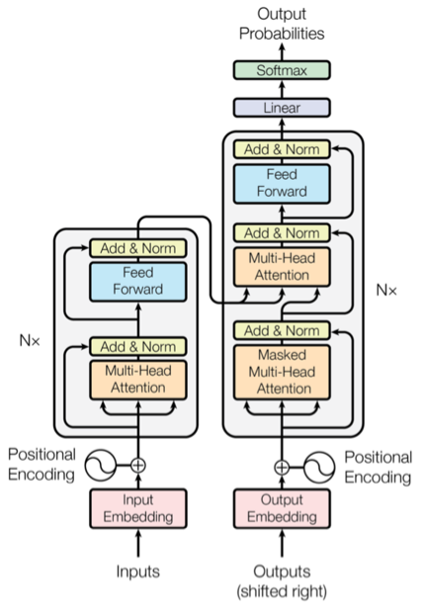
Transformer components
The transformers is made up of two components –
The Encoder stack
The Decoder Stack
The transformer has an encoder-decoder architecture. They are composed of modules that contain feed-forward and attention layers.
Computers don’t understand words, they understand numbers, vectors and matrices.
The idea is to map every word close to each so that it can be easy to map while embedding (input embedding) is called embedding space.
Transformers are Faster (as words can be processed Simultaneously) and Deep Bidirectional Learners (context of words are better Learnt).

Slide 4

BERT
BERT stands for Bidirectional Encoder Representations from Transformers.
Transformer Based architecture.
BERT applies the bidirectional training of Transformer to language modeling, learns the text representations.
We use BERT for text classification in bidirectional way.
Generally, language models read i/p sequences in one direction ,this works well if the aim is to predict next word.
BERT is just an encoder. It does not have a decoder. The encoder is responsible for reading text input and processing. The decoder is responsible for producing a prediction for the task.

Slide 5



Problems to solve
We can use BERT to Learn :
Neural Machine Translation.
Question Answering.
Sentiment Analysis.
Text summarization.
We need to understand the Language , The 2 tasks that we use is : (BERT Training)
Pretrained BERT to understand Language.
Fine tune BERT to Learn Specific Task.

Slide 6

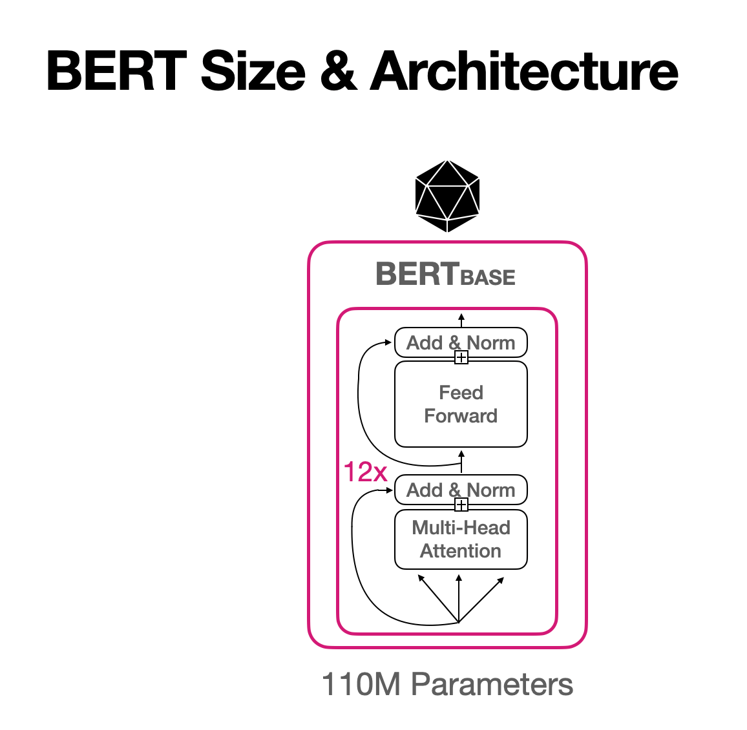

Bidirectional Encoder Representation from Transformers
Pre-training Phase : - What is Language ? What is context ?
BERT learns language by training two unsupervised tasks simultaneously
Masked Language Model (MLM) : Before feeding word sequences into BERT, 15% of the words in each sequence are replaced with a [MASK] token.
Next Sentence Prediction (NSP) : In the BERT training process, the model receives pairs of sentences as input and learns to predict if the second sentence in the pair is the subsequent sentence in the original document.

Slide 7
Bidirectional Encoder Representation from Transformers
Fine tuning Phase : How to use language for specific (NLP) task.
Fine-tuning in NLP refers to the procedure of re-training a pre-trained language model using your own custom data.

Slide 8
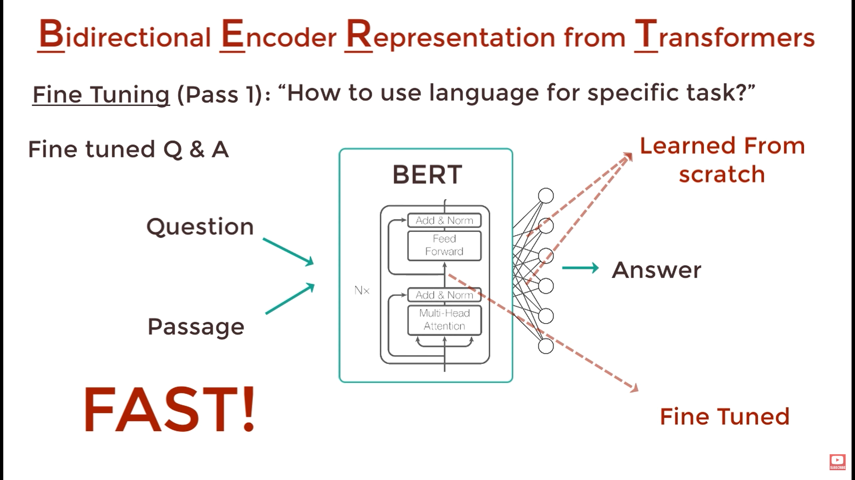

Slide 9
Model Details
In our model we use pretrained BERT embeddings model “ bert-base-multilingual-cased “ .
Dataset: ICDAR 2019 corresponding Corpus (22M words)
Content - "[OCR_toInput] " => Raw OCRed text to be de-noised. - "[OCR_aligned] " => Aligned OCRed text. - "[ GS_aligned] " => Aligned Gold Standard text.
Kernel Size: Convolutional Layers with 4 different sizes (2,3,4 & 5),each have 32 filters.
Training Time: 1M steps (4 epochs).
Optimizer: AdamW, 3e-5 learning rate, linear decay.
Trained on Tesla T4 GPU slice for 2 - 3 Hours.
Stride=1 is used by both convolutional and maxpool layers, which has an influence on information sharing inside the n-grams, which are 2-, 3-, 4-, and 5-grams.

Slide 10


Thank you

